Slide 1
Linux Basics

Slide 2
What is Unix?
A multi-task and multi-user Operating System
Developed in 1969 at AT&T’s Bell Labs by
Ken Thompson (Unix)
Dennis Ritchie (C)
Douglas Mcllroy (Pipes - Do one thing, do it well)
Some other variants: System V, Solaris, SCO Unix, SunOS, 4.4BSD, FreeBSD, NetBSD, OpenBSD, BSDI

Slide 3

What is Linux?
A clone of Unix
Developed in 1991 by Linus Torvalds, a Finnish graduate student
Inspired by and replacement of Minix
Linus' Minix became Linux
Consist of
Linux Kernel
GNU (GNU is Not Unix) Software
Software Package management
Others
http://www.linuxdevices.com/files/misc/ibm-watchpad.jpg

Slide 4

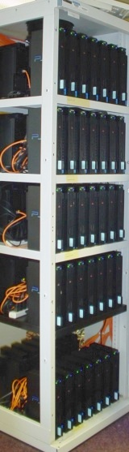

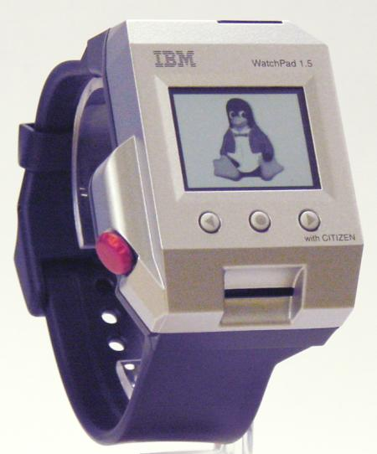
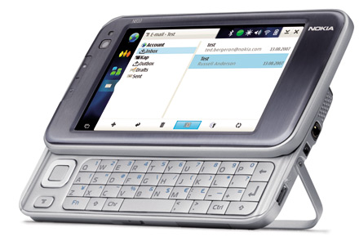



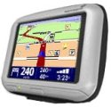
What is Linux?
Originally developed for 32-bit x86-based PC
Ported to other architectures, eg.
Alpha, VAX, PowerPC, IBM S/390, MIPS, IA-64
PS2, TiVo, cellphones, watches, Nokia N810, NDS, routers, NAS, GPS, …

Slide 5
Which Linux Distribution is better?
> 300 Linux Distributions
Slackware (one of the oldest, simple and stable distro.)
Redhat
RHEL (commercially support)
Fedora (free)
CentOS (free RHEL, based in England)
SuSe ( based in German)
Gentoo (Source code based)
Debian (one of the few called GNU/Linux)
Ubuntu (based in South Africa)
Knoppix (first LiveCD distro.)
…

Slide 6
Which Linux Distribution is better?
Ask yourself these questions
Is it going to be around in 5 yrs?
Is it going to stay on top of the latest security patches?
Is it going to release updated software promptly?
If I have problems, will the vendor talk to me?

Slide 7
The Linux System
User commands includes executable programs and scripts
The shell interprets user commands. It is responsible for finding the commands and starting their execution. Several different shells are available. Bash is popular,
The kernel manages the hardware resources for the rest of the system.

Slide 8
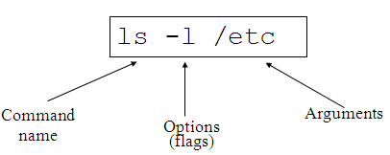
The Command Line
Accessing UNIX through a terminal
telnet [hostname] [port]
The omnipresent failsafe. Nowadays, turned off due to lack of adequate security.
ssh [user@]hostname
Secure. Data is encrypted over “the wire”. What we use.
Not always available outside CU due to different versions, implementations, platform availability.
Command Structure
Command <Options> <Arguments>
Multiple commands separated by ; can be executed one after the other
Log in!
3 tries to get valid username and password right
Show who is logged in
w or who
finger
Logout!
exit
CTRL-D

Slide 9
Accessing Documentation 1/2
Commands are generally documented using the command man.
man pages are subdivided into various sections
Example: Documentation of the man command
man man
Example: Documentation of the time command
man time
Example: Documentation of the time C library function
man 3 time
man will present the manual page of the specified entry using more or less.
In Linux, the default is less, but can be overridden
less presents a screen-full at a time. ‘spacebar’ moves forward, ‘b’ moves backward, ‘$’ moves to end, ‘q’ quits, ‘?’ helps.

Slide 10
Accessing Documentation 2/2
A few commands (such as diff, gcc, awk) are doccumented using info.
info is GNU-specific
Uses its own hypertext ‘viewer’.
arrow-keys select different links
space pages forward
‘u’ goes back “up” a hyperlink level, like “back” in browsers
Most commands have HTML references on the WWW.

Slide 11
Getting around the filesystems 1/6
UNIX files are organized just like they are with PC’s and MAC’s
Files are contained in collections of Directories.
Directories may contain other Directories
Different drives are “mounted” onto directories – there are no drive letters!!
The “top level” directory is called the “root” directory and is referred to by “/”
The current directory is referred to by “.”
The directory one level up is referred to by “..”
More dots don’t get you more levels up. ☹
Shortcuts in Windows are called soft-links. Act just like normal files, directories, or whatever it is they refer to.
Other filetypes include named pipes, character devices, block devices, sockets.

Slide 12
Getting around the filesystems 2/6
Commands to navigate the directories:
pwd
ls
ls file; ls directory ; ; ls –a ; ls –l ; ls -R
cd
cd ..
cd /home/tim/projects
cd ~/projects
cd ~tim/projects
cd $HOME/projects
mkdir
rmdir
mv
mv oldfilename newfilename
mv file1 file2 file3 newtargetdirectory
cp -- syntax like mv
cp –r dir1 dir1copy
rm
push
pop
find
find . –ls
find . –type d –print
find . –type f –exec “echo” “{}” “;”
Notes:
pwd Print or list the present working directory with full path.
ls List contents of a directory.
Ex: ls, ls –l , ls –al, ls –ld, ls –R
(-rwxrwxr-x 1 juan juan 0 Sep 26 12:25 foo )
|more will list page wise
cd Change the current directory. With no arguments "cd" changes to the users home directory. (cd <directory path>)
mkdir Make a directory.
Ex: mkdir <directory name> : Makes a directory
Ex mkdir –p /www/chache/var/log will create all the directories starting from www.
mv Move or rename a file or directory.
Ex: mv <source> <destination>
cp Copy a file from one location to another.
Ex: cp file1 file2 : Copy file1 to file2
Ex: cp –R dir1 dir2 : Copy dir1 to dir2
rm Delete files (Remove files). (rm –rf <directory/file>)
rmdir Remove a directory. The directory must be empty. (rmdir <directory>)
find Find files (find <start directory> -name <file name> -print)
Ex: find /home –name readme -print
(Search for readme starting at home and output full path.) “/home" = Search starting at the home directory and proceed through all its subdirectories
"-name readme" = Search for a file named readme
"-print" = Output the full path to that file

Slide 13
Getting around the filesystems 3/6
File compression, backing up and restoring
compress Compress data.
uncompress Expand data.
cpio Can store files on tapes. to/from archives.
gzip - zip a file to a gz file.
gunzip - unzip a gz file.
tar Archives files and directories. Can store files and directories on tapes.
Ex: tar -zcvf <destination> <files/directories> - Archive copy groups of files. tar –zxvf <compressed file> to uncompress
zip – Compresses a file to a .zip file.
unzip – Uncompresses a file with .zip extension.

Slide 14
Getting around the filesystems 4/6
cat View a file
Ex: cat filename
cmp Compare two files.
cut Remove sections from each line of files.
diff Show the differences between files.
Ex: diff file1 file2 : Find differences between file1 & file2.
echo Display a line of text.

Slide 15
Getting around the filesystems 5/6
grep List all files with the specified expression. (grep pattern <filename/directorypath>) Ex: ls –l |grep sidbi : List all lines with a sidbi in them.
Ex: grep " R " : Search for R with a space on each side
sleep Delay for a specified amount of time.
sort Sort a file alphabetically.
uniq Remove duplicate lines from a sorted file.
wc Count lines, words, characters in a file. (wc –c/w/l <filename>).

Slide 16
Getting around the filesystems 6/6
File viewing and editing
emacs Full screen editor.
pico Simple text editor.
vi Editor with a command mode and text mode. Starts in command mode.
gedit GUI Text Editor
tail Look at the last 10 lines of a file.
Ex: tail –f <filename> ,
Ex: tail -100 <filename>
head Look at the first 10 lines of a file. (head <filename>)

Slide 17
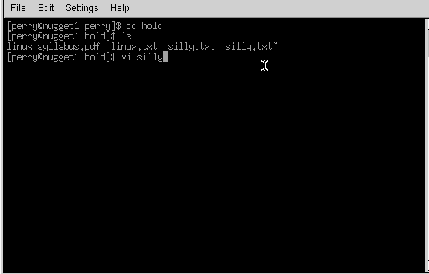
The VI Editor 1/2
Opens from terminal window
Notes:
From the command line, type vi blah
The editor will appear on-screen, with a tilde, ~, on evey line, and at the bottom of the screen it says "blah" [new file]. If you want to put anything into this file, you have to put vi into insert mode. Do this by typing the letter 'i' on its own. "-- INSERT --" appears on the bottom of the screen. Now you can type in anything you want. Try typing "Hello", and then on a new line "World". Now try going back up to the line above, using the cursor keys and try to delete Hello. You wont be able to. When you give a Carraige Return (Press Enter in other words), the text on that line becomes static. If you want to delete it, heres how.
Press your Esc button on the top left of the keyboard, and the "-- INSERT --" at the base dissapears. Vi is ready to accept a new command. The only thing here is that vi will only delete what is in front of the cursor, let me show you. Bring the cursor to the start of Hello, and press the x key once. Now only 'ello' remains. This doesnt really make any sense, so we'll delete the line altogether. Press 'd' twice in quick sucession. Now we have the word 'World' on its own. Press 'i' and insert "Hello" again. This time, leave the text in insert mode. Press the "Insert" key on your keyboard, its above the cursor keys. The "-- INSERT --" at the base of the screen has been replaced with "-- REPLACE --". Now type the word "Nurse" over the existing "World". Press Esc again to return to the ready mode.
Vi has a search tool too, which I find indispensable. From the ready mode, type in a slash, /, and input the text you want to look for. Remember, since Linux is case sensitive, looking for "money" is not the same as looking for "Money".
Well, what about saving the file, or quitting without saving? What about just quitting? Its easy. From the ready mode, type in ":w" to write the file ... you already supplied the file name when you typed 'vi blah' earlier. The editor will return this on the status line : "blah" [New File] 1 line, 12 characters written. Lets quit out of it altogether. Type in ":q“or :quit!. You have been returned to the command prompt. There was an easier way of doing that ... from the ready mode in the editor, you could have just typed in, in cap:itals, "ZZ" ... this saves the file and quits. If you had wanted to quit without saving the changes, you could have just typed in ":q!", and nothing would have saved ... blah wouldn't have existed.

Slide 18
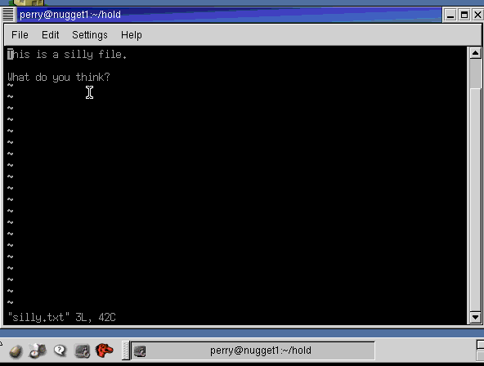
The VI Editor 2/2
http://www.linux.ie/newusers/beginners-linux-guide/
Notes:
Smaller program, more primitivy.
There are 3 modes:
Command mode
X mode
Edit mode
go into insert mode (by either pressing the letter 'i' or the insert key)
delete text to the right of the cursor one character at a time with 'x'
delete text one line at a time by pressing 'd' twice in quick succession
search for text with '/'
save text to a file (:w) and exit vi (:q or :q! if you don't mind losing changes).
“Exc” key will take you to the command mode.
I – Insert
Esc
Shift “:” and “wq” – write my changes and quit
“dd” delete line of text
“cat” prints file to the screen
Say that again. You can have a command repeated a number of times by first typing in the amount of times that you want the command to occur so to delete a seven lettered word just type '7x'. You might wonder about the above line 'delete text to the right of the cursor' - is this excess pedantry or is it leading on to something useful? The latter applies; pressing 'X' deletes the character immediately to the left of the cursor and typing 7X, for example, deletes any seven characters that are immediately to the left of the cursor.
So what happens if you are at the end of a 21 character line and you type '30X' - do nine charaters of the preceding line get deleted? No, the above line will remain intact but any the text to the left of the cursor will indeed get deleted.
You can, if you want to, repeat a command just once; by pressing '.', this I suppose could be called the 'redo' button; it has a counterpart ('u') which will undo the last change.
There's more than one way...to delete a word. Now, just to get back to deleting words. I mentioned that you could use '7x' to delete a seven lettered word. That's all well and good if you don't mind counting off the number of letters in whatever word it is that you want to delete. There's a better way to do this (there's always a better way). You can delete words with 'dw' and 'db'; use 'dw' for deleting words to the right of the cursor and 'db' for deleting words to the left - and if you want to delete seven words then use '7dw'.
Moving the cursor. This moves on (hur, hur) rather nicely to the next thing that I want to get to - moving the cursor around. Obviously you can use the cursor keys but there are other ways of doing it. For example, if you want to move to the start of the previous sentence use '(', if you want to move on to the next one then press ')'. You can go squiggly if you want to move around one paragraph at a time and use '{' or '}' respectively. If you only want move around by a few words then use 'W' and 'B'. The great thing about all of this is precision.
And I haven't even gotten to the good stuff yet.
Cut & Paste. Do you remember about 'dd', and that it deletes lines one at a time? Well here's something nifty that you can do with it and just one other command. Let's say that you have a four line block of text that you want to move (be it source code or whatever). Move the cursor to the first line of that block of text and type '4d', then move the cursor to where you want to put the text and type 'p'. This will put the text you previously deleted back in, after the cursor. Using 'P' will insert the deleted text before the cursor.
Copy & Paste. So now you know how to cut and paste text in vi. The next thing to learn is how to copy and paste text and there really isn't anything to it at all; instead of putting text into the memory buffer by deleting it text needs to be put there without deleting it. This is done by yanking the text. If you want to yank four lines of text into the buffer, move the cursor to the first line of that block of text and type '4Y'. You can then use 'p' or 'P' to place a copy of that text elsewhere.
Other ways to change text. There are a few other ways that you can use to edit text. If, for example, you have typed in 'ilug' where you meant 'ILUG' you can either press 'R' with the cursor at the start of 'ilug', type the abbreviation in with caps lock on and press ESC to get out of replace mode. Or you can do it quickly by positioning the cursor and then typing '4~'. And if you want to delete to the end of a line 'D' will work just fine.
Windows. Sometimes it can be quite handy to have more than one file open in vi at the same time - specifications in one 'window' and the source code in another for example. To do this you need to have one file open first and then press Ctrl & w (the control and 'w' keys at the same time) followed by 'n'. This will result in a new window created at the top of the screen, with the screen divided equally between the two windows. To edit a file in this new window you need to type ':e' followed by the name of the file. You can keep on doing this until you have as many files open as is needed.
Moving between the windows is fairly simple. Press Ctrl & w first to let vi know that you want to do something about the windows and then press:
t if you want to move to the top one
b if you want to move to the bottom window
Up arrow or down arrow to move to a window in the middle, you can also use 'j' or 'k' if you don't have any arrow keys for some reason.
Typing ':q' will close the window that the cursor is in, if you want to close all other windows then press 'Ctrl & w' followed by 'o'.

Slide 19
The Emacs Editor Background, Overview
Emacs is a powerful and extensible text editor.
Emacs originally was an acronym for Editor MACroS.
The first Emacs was a set of macros written in 1976 at MIT by Richard M Stallman.
Emacs has become a standard editor used by programmers worldwide.
There are several varieties of Emacs, by typing emacs at the command prompt, you are throw into one of two modes:
The terminal-mode (from an ssh connection or without X Window):
This mode has no toolbars, and all commands are given via keyboard.
Do not think that this is a useless mode, as sometimes the only connection that you may have to a machine is remote.
The graphical-mode (requires X Window):
It looks similar to the terminal-mode, but with some added features for X.
There is a toolbar across the top of the window, from which many common tasks can be accessed.
You may wish to type emacs& (note the &), as this will free up the shell for other tasks (such as compiling).

Slide 20
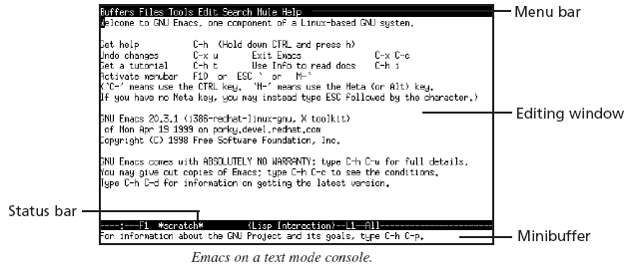
The Emacs Editor Programming with Emacs 1/7
Starting and Stopping Emacs
To start Emacs, type: emacs or emacs filename
To exit of Emacs, type Ctrl-x

Slide 21
The Emacs Editor Programming with Emacs 2/7
Moving Around
M-b: Moves the cursor to the beginning of the word left of the cursor
M-f: Moves the cursor to the end of word to the right of the cursor
M-a: Moves to the beginning of the current sentence
M-e: Moves to the end of the current sentence
C-n: Moves the cursor to the next line
C-p: Moves the cursor to the previous line
C-a: Moves the cursor to the beginning of the line
C-e: Moves the cursor the end of the line
C-v: Moves display down one screen full
M-v: Moves display up one screen full

Slide 22
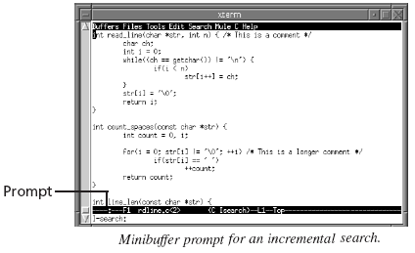
The Emacs Editor Programming with Emacs 3/7
Search and Replace
Type C-s, the minibuffer prompts for a search string

Slide 23
The Emacs Editor Programming with Emacs 4/7
Type the string, Emacs moves the cursor to the first occurrence
For the next occurrence, type C-s again
Esc cancels the search, leaving the cursor at its current location
Saving and Opening Files
C-x C-s: save a file
C-x C-w: save the file using a new name
C-x C-r: open file in read-only mode. Then, type the filename in the minibuffer, and press Enter
C-x C-f: open a file into the current buffer, type to “visit” the file, type the filename in the minibuffer, and press Enter

Slide 24
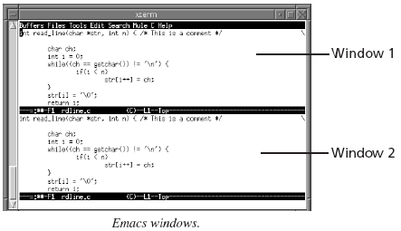
The Emacs Editor Programming with Emacs 5/7
Multiple Windows
C-x 2: it splits the current window into two windows

Slide 25
The Emacs Editor Programming with Emacs 6/7
C-x o: Move to the other window
C-M-v: Scroll the other window
C-x 0: Delete the current window
C-x 1: Delete all windows except the current one
C-x 2: Split screen into two windows
C-x 3: Split the screen horizontally, rather than vertically
C-x 4 C-f: “Visit” a file into the other window
To close a buffer, switch to that buffer and type C-x k and press Enter

Slide 26
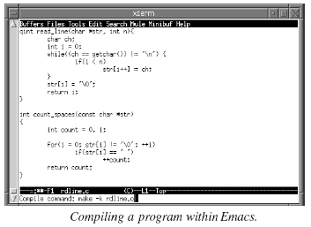
The Emacs Editor Programming with Emacs 7/7
Compilation Using Emacs
M-x compile: compiles code using, by default, make -k
Example: you are working on a file named rdline.c, type M-x compile to compile it. Then type rdline.o

Slide 27
The Emacs Editor Tutorial and References
Emacs comes with a built in tutorial.
To access it type F1 then T.
The tutorial covers many of the basic tasks, such as cursor movement to more advanced skills such as searching and replacing text.
References - from basic commands to the full manual
A BASIC EMACS Reference Card
The Complete Manual Online - at GNU.org

Slide 28
Shell Shells Overview
An interface between the Linux system and the user
Used to call commands and programs
An interpreter
Powerful programming language
“Shell scripts” = .bat .cmd EXEC REXX
Many available (bsh; ksh; csh; bash; tcsh)

Slide 29
Shell Another Definition of a Shell
A shell is any program that takes input from the user, translates it into instructions that the operating system can understand, and conveys the operating system's output back to the user.
i.e. Any User Interface
Character Based v Graphics Based

Slide 30
Shell Why Do I Care About The Shell?
Shell is Not Integral (built-in) Part of OS
UNIX is among the firsts to separate shells from the OS.
Compare to MS-DOS, Mac, Win95, VM/CMS
GUI is NOT Required
Default Shell Can Be Configured
chsh -s /bin/bash
/etc/passwd
Helps To Customize Environment

Slide 31
Shell Shell Scripts
#!/bin/bash
while
true
do
cat somefile > /dev/null
echo .
done
/* */
do forever
‘PIPE < SOME FILE | hole’
say ‘.’
end

Slide 32
Q & A

